Slide 1
بِسْمِ اللَّهِ الرَّحْمَنِ الرَّحِيمِ والصَّلَاةِ والسَّلامُ عَلَيَّ سَيِّدِ الْمُرْسَلِين، الْحَمْدُ لِلَّهِ الَّذِي عَلِمَ الْقُرْآنَ، علَّم الإنسانَ مَا لَمْ يعلَم، وَالصَّلَاةُ وَالسَّلَامُ عَلَى خَيْرِ أمامً بَعَث لِلنَّاس سَيِّدِنَا مُحَمَّدٍ وَعَلَى آلِةِ وصُحْبَةٌ وَسَلَّم. أما بعد

Slide 2
Prediction of Superconductor critical temperature using Machine learning techniques
By:
Mohamed Ahmed Ahmed Mohamed Ali
Supervised By:
Ph.D. Mourad Raafat

Slide 3

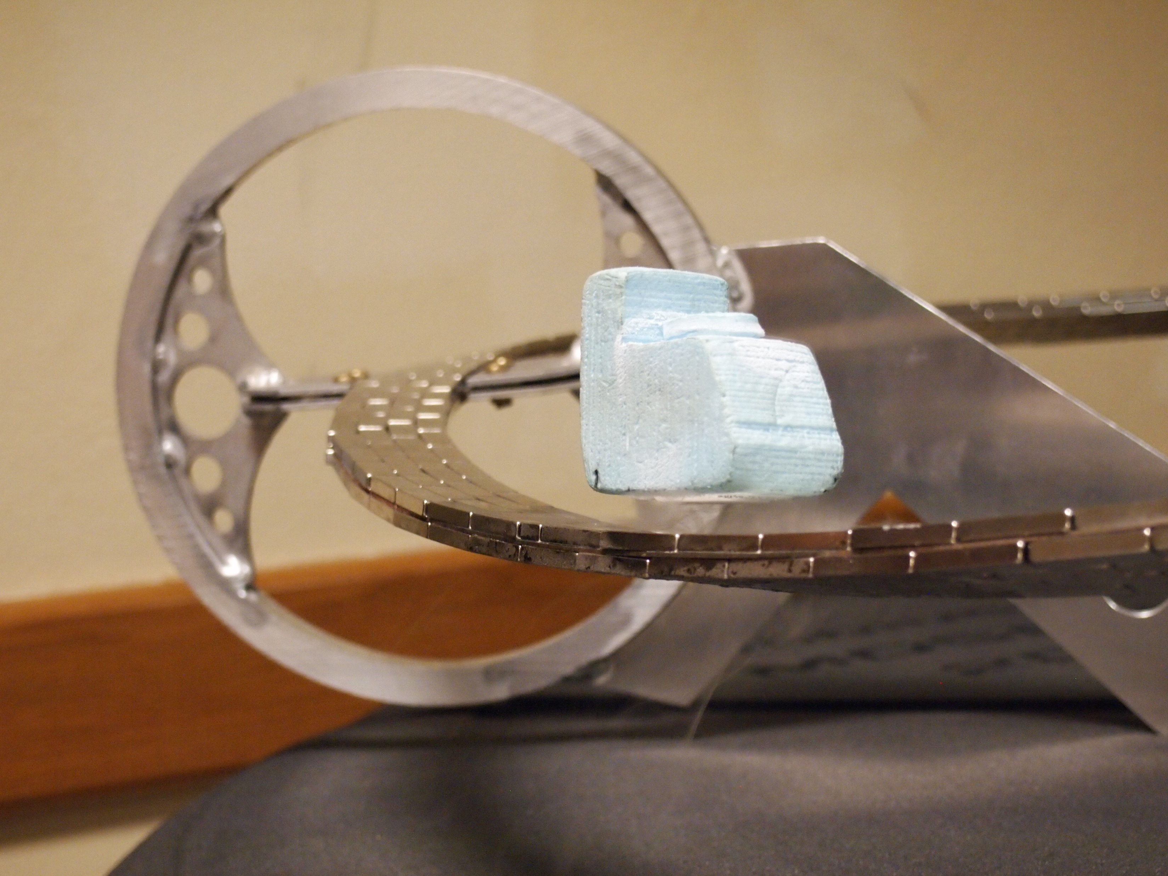
Superconductors

Slide 4


Problem need Solution

Slide 5
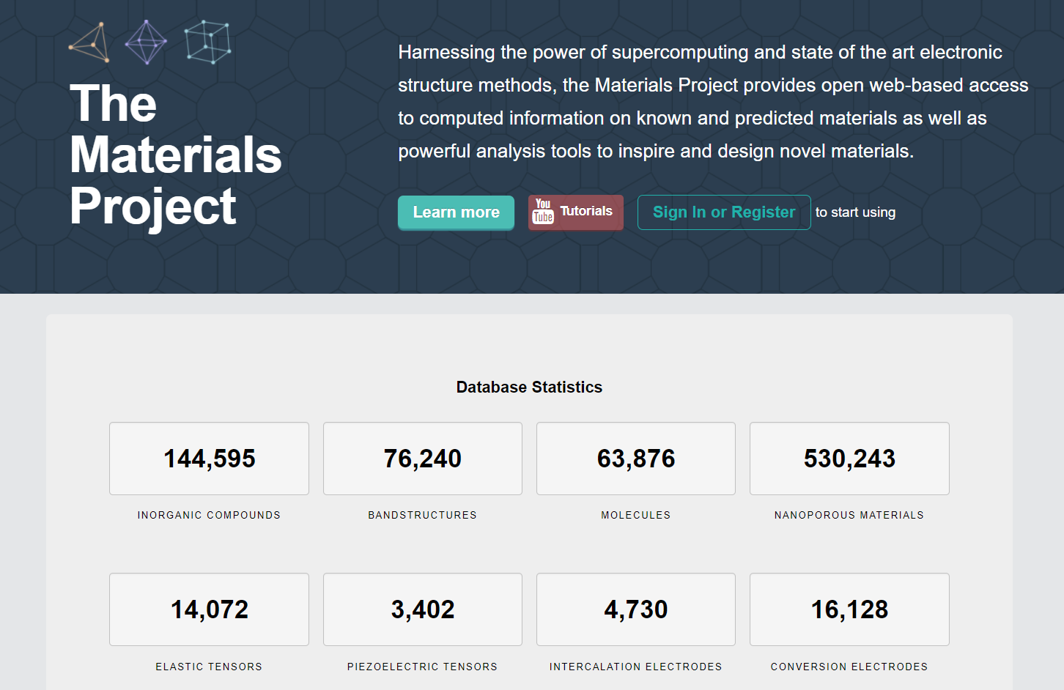
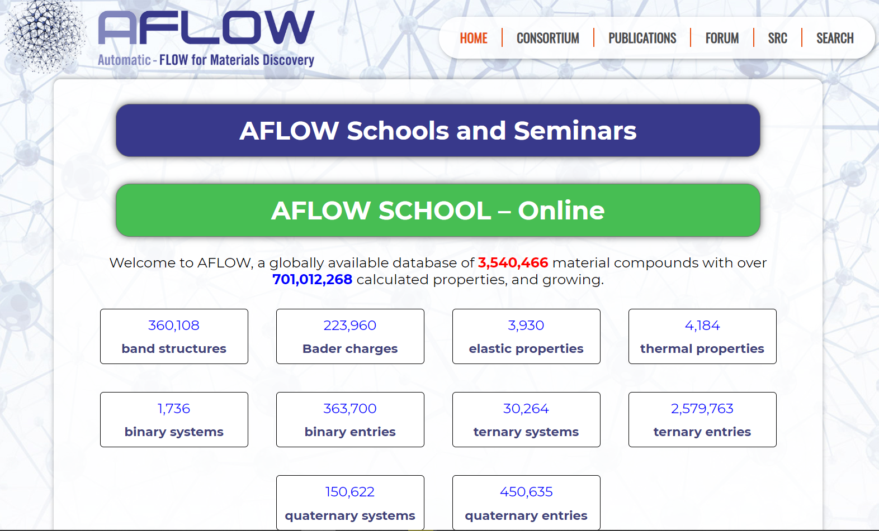
Availability of Data

Slide 6

Machine Learning

Slide 7
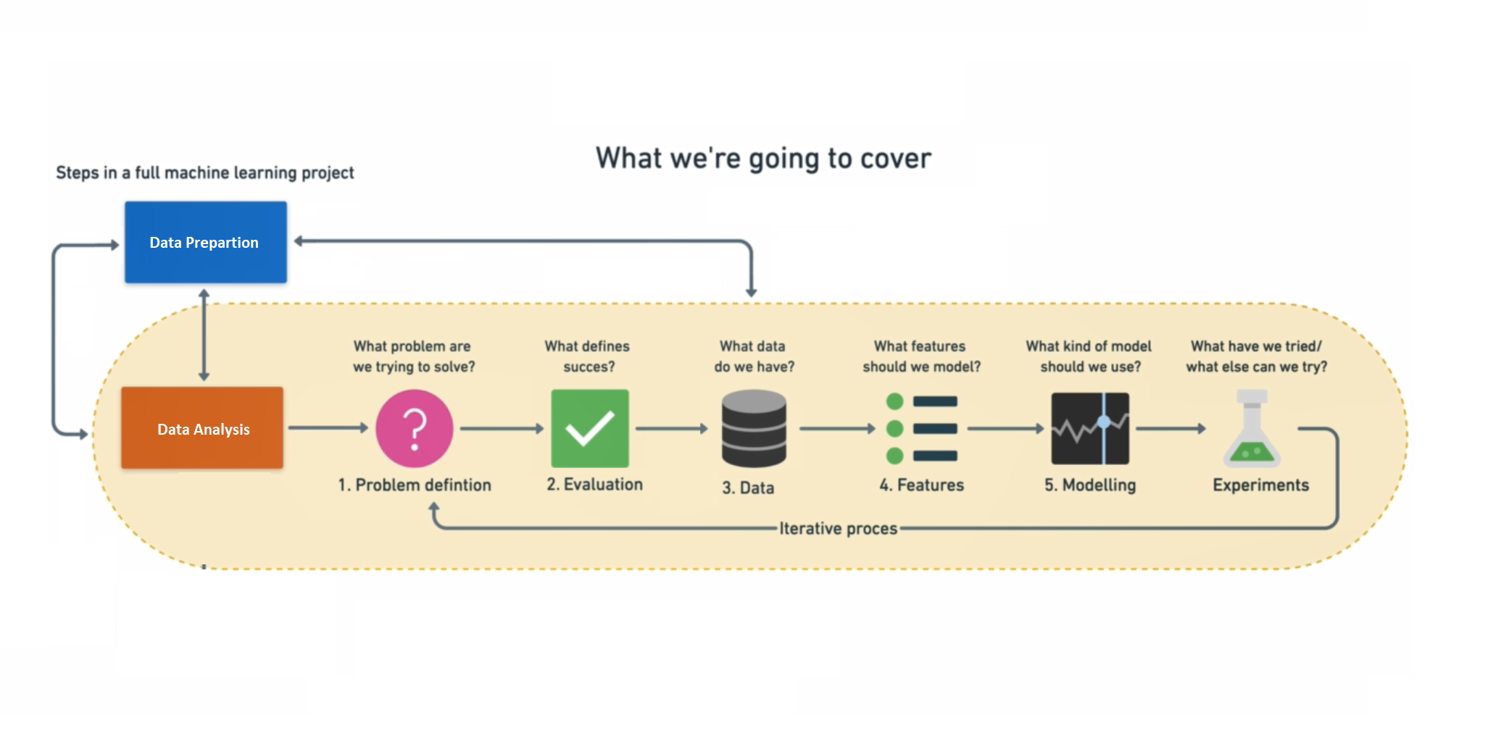
Framework

Slide 8
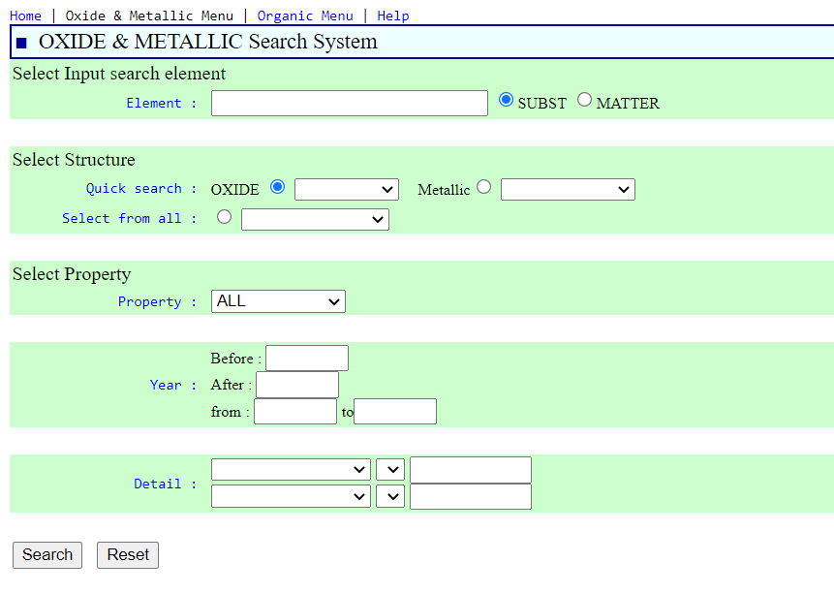
SuperCon

Slide 9

Data Preparation

Slide 10
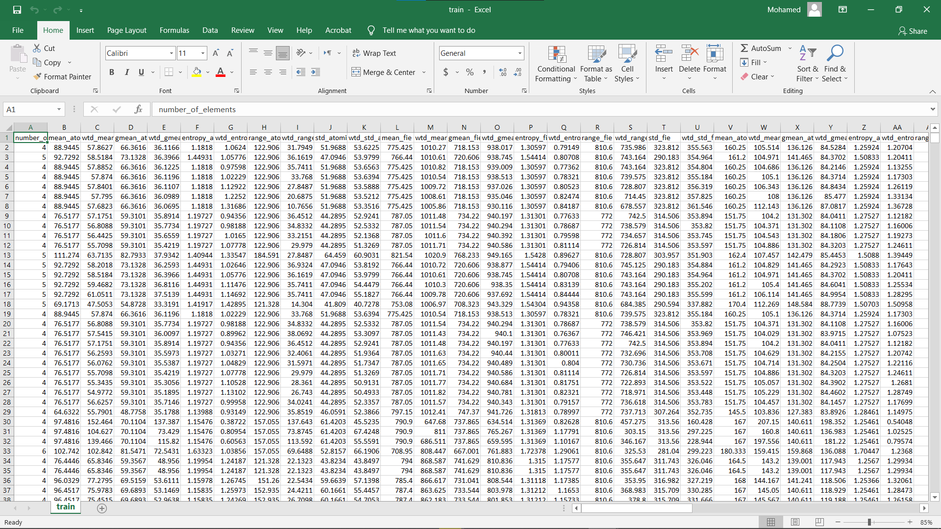
Data Preparation

Slide 11
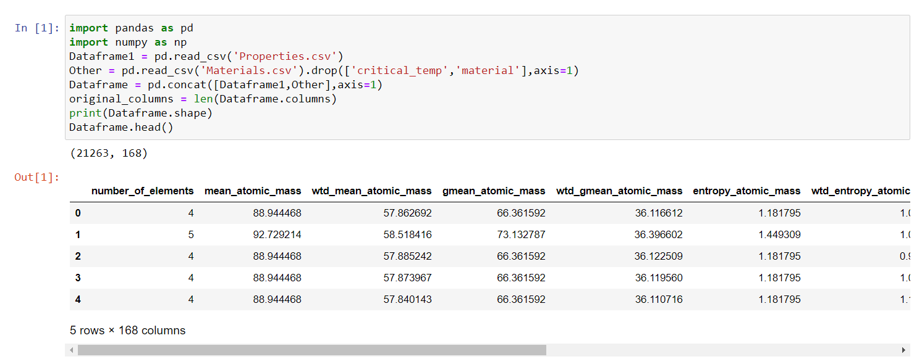
Data Preparation

Slide 12
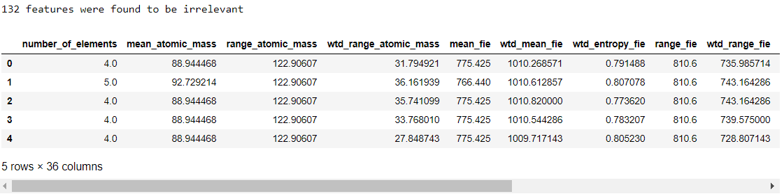
Features Engineering

Slide 13

Model Selection

Slide 14
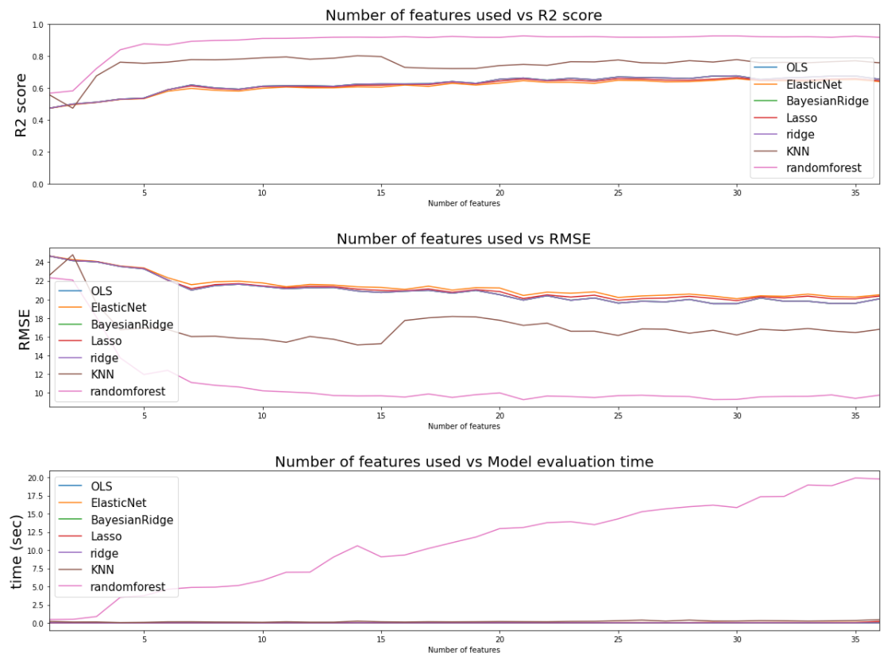
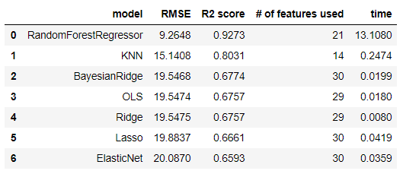
Model Comparison
s

Slide 15
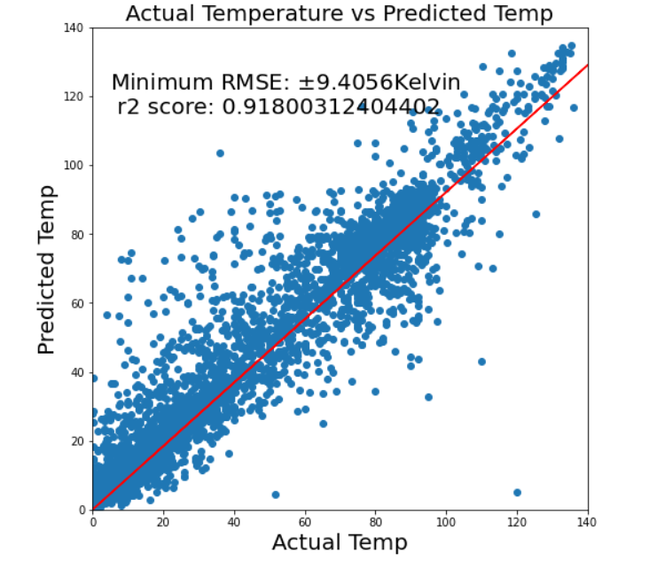
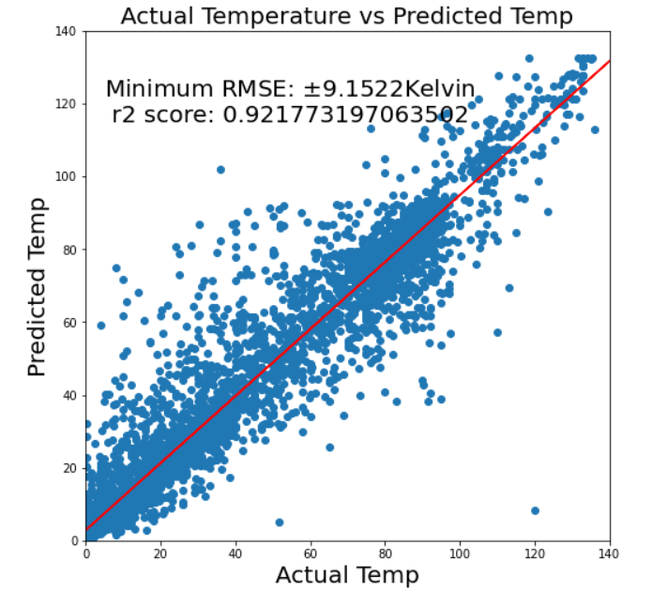
Result Before & After Fine Tunning

Slide 16
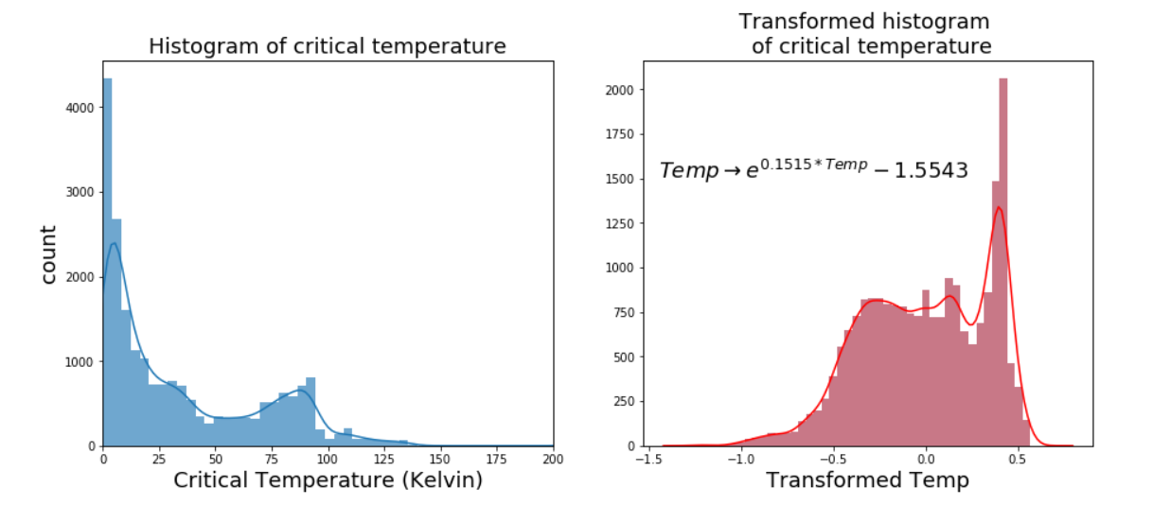
Normalization Test Run

Slide 17
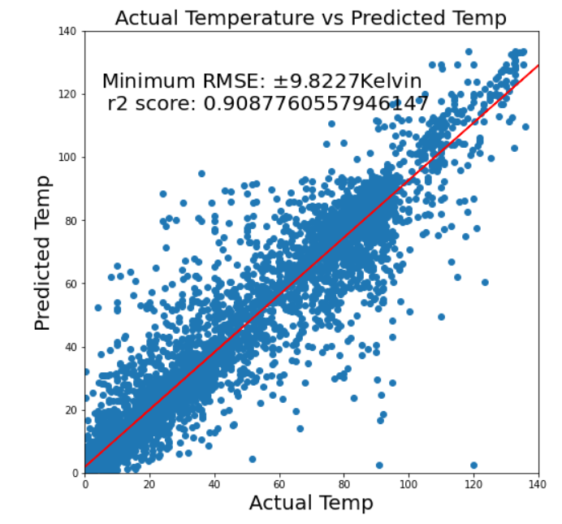
Normalization Result

Slide 18
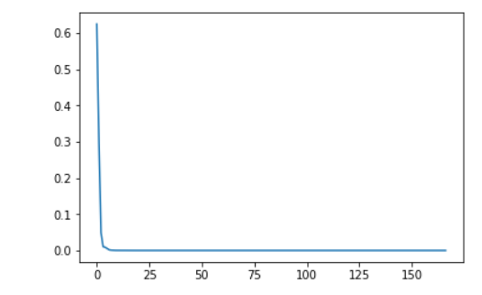
PCA Result
Due to the average absolute value of the correlation among the features is 0.35.
This indicates that the features are highly correlated. Motivated by this result, we attempted to reduce the dimensionality of the data using (PCA).
PCA analysis did not show any benefits in reducing the dimensionality since a large number of principal components were needed to capture a substantial percentage of the data variation

Slide 19
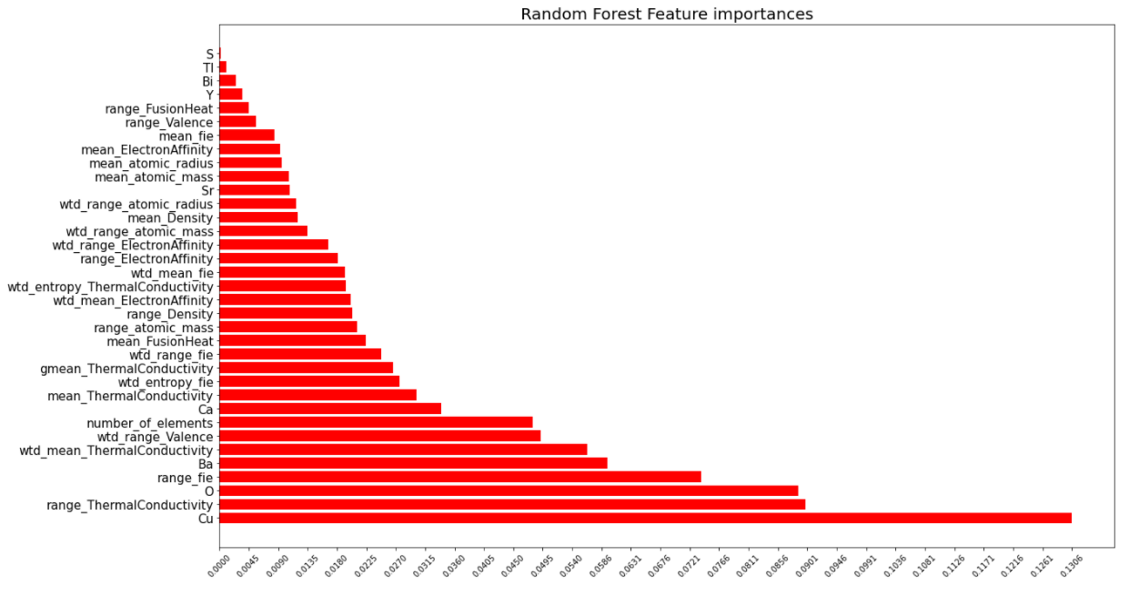
Conclusion: Feature Importance's

Slide 20
Future Improvement
We aim to increase our sample of data by importing new features from different databases like AFLOW and material science.
We aim to make a classification model and use only high Tc superconductors.
Combine the classification and regression model in one pipeline.
Using machine learning technique like deep learning to predict more superconducting materials with high Tc.

